Slide 1
Welcome!

Slide 2
Congress, Keep Your Promise Our Work for Thriving Communities Continues

Slide 3
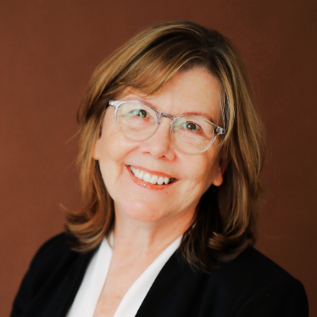
OUR POLICY EXPERTS
Laura Peralta-Schulte
Senior Director of Public Policy and Government Relations
Mary J. Novak Executive Director
Jarret K. Smith
Government Relations Advocate
Minister Christian S. Watkins
Government Relations Advocate
#NETWORKWebinar | @NETWORKLobby

Slide 4
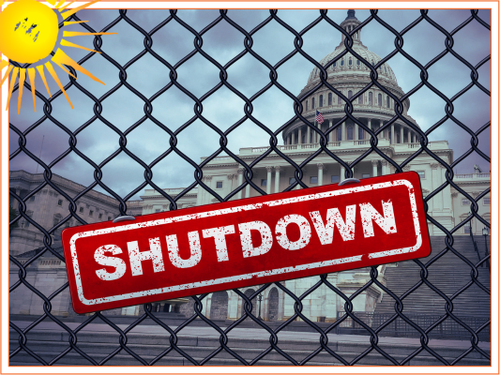
Faithfully Funding the Government
End of fiscal year: September 30th
To avoid a government shutdown, Congress must…
Pass all 12 Appropriation Bills
OR pass a continuing resolution
#NETWORKWebinar | @NETWORKLobby

Slide 5
State of Play on Appropriation Bills
Senate: Finished all 12 bills at amount promised in Debt Ceiling debate
House: Passed 1 bill out of committee
All House bills significantly cut from agreed amounts under Debt Ceiling debate
CR is the only choice given September deadline!
#NETWORKWebinar | @NETWORKLobby

Slide 6
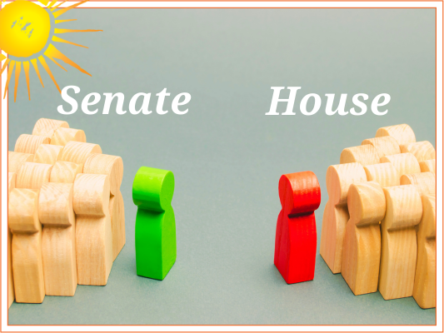
House & Senate in Conflict
Senate
Poised to move forward with CR
Includes extra funding for Ukraine, emergency disasters, and immigration
House
33 members of Freedom Caucus demands
Speaker can only lose 5 members to pass GOP-only bill
#NETWORKWebinar | @NETWORKLobby

Slide 7
Threats to Build Anew Agenda
Lower funding than decided in Debt Ceiling agreement
Non-related bills “riders” get attached
Government shutdown
#NETWORKWebinar | @NETWORKLobby

Slide 8
Misaligned Funding Priorities: WIC
Special Supplemental Nutrition Program for Women, Infants, and Children (WIC)
Senate bill funds WIC at Biden budget level
$6.3 billion, $615 million over FY 2023 appropriations
House cuts would end longtime bipartisan support of WIC
Despite increased need
#NETWORKWebinar | @NETWORKLobby

Slide 9
Misaligned Funding Priorities: WIC
House freezes WIC funding at 2023 levels
Increasing need and food inflation costs
Targets fruit and vegetable benefits with deep cuts
Expect waiting lists and poor health & developmental outcomes
Up to 700,000 young children, pregnant individuals, and new parents will be turned away
4.6 million current participants will face deep cuts
#NETWORKWebinar | @NETWORKLobby

Slide 10
Examples of Bad Policy “Riders”
Immigration: border militarization and increased family detention
Tax: cut funding for the IRS and eliminate new “Free File” program
Food: targeting SNAP benefits
Cut funding, reduce family benefits
Strengthen work requirements
Restrict states’ flexibility to respond to hardships
#NETWORKWebinar | @NETWORKLobby

Slide 11
Looking Back at CTC
Official purpose: to help families pay for the cost of raising children
2017 Trump Tax Bill, the Tax Cuts and Jobs Act, modified subsidies families were eligible to receive
Maximum credit per child: $2,000
Refund amount per child: $1,400 (2022 amount increased to $1,500 to compensate for inflation)
#NETWORKWebinar | @NETWORKLobby

Slide 12
Who Has Access to CTC?
Not fully refundable
Phases out at high income levels
$400,000 for married couple filing jointly
$200,000 for single parent
#NETWORKWebinar | @NETWORKLobby
Notes:
New Cap total
Credit Phase in Rule
Families who paid little-to-no federal income tax were not eligible for full benefit of the credit
Wealthy families given opportunity to claim entire credit
Married couple credit phase out: $400,000
vs.
Single parent credit phase out: $200,000

Slide 13
CTC in the American Rescue Plan
$3,000 per child ages 6+, $3,600 per child under 6
Fully refundable
Partially paid in monthly installments; the rest as tax return
#NETWORKWebinar | @NETWORKLobby

Slide 14
Our Goal
Restore all of the American Rescue Plan Child Tax Credit
Drastic reduction in child poverty!
#NETWORKWebinar | @NETWORKLobby
Notes:
CTC has a clear impact on child poverty!
716,000 Black children and 1.2 million Latinx children lifted out of poverty
91% of low-income families used monthly payments for food, rent, and other basic life expenses
Research shows that child poverty CAN be eliminated

Slide 15
Tax Bill State of Play
House Ways and Means Committee passed a tax bill this summer – tax credits for businesses
House and Senate Democrats are pushing for a refundable monthly Child Tax Credit in any tax bill this year
Rep. DeLauro and Senators Bennet, Booker, & Brown have introduced a Child Tax Credit bill
Some GOP Senators interested in including Child Tax Credit
#NETWORKWebinar | @NETWORKLobby

Slide 16
2023 Farm Bill
Must be reauthorized every 5 years
Expires September 30, 2023
Includes nearly all federal agriculture and food policy
80% of Farm Bill funding is allocated to SNAP – Supplemental Nutrition Assistance Program
#NETWORKWebinar | @NETWORKLobby

Slide 17
Protecting SNAP
Prevent cuts to current benefits
Prevent expansion of work-reporting requirements
End lifetime ban on SNAP for individuals convicted of drug felonies
#NETWORKWebinar | @NETWORKLobby
Notes:
NETWORK’s priorities for the Farm Bill are clear: protect SNAP in two ways
Hold the line against GOP extremists demands for cuts to current benefits and more punishing work requirements
End Farm Bill’s lifetime ban on SNAP for individuals convicted of drugs felonies

Slide 18
Cuts to SNAP Don’t Make Sense
92% to households living at or below the poverty line
1/4 beneficiaries are children
Just enough funds for a subsistence diet
Has strict eligibility rules – including work-reporting requirements
Key support to farmers and rural economies
Improves health, education, and economic self-sufficiency
#NETWORKWebinar | @NETWORKLobby
Notes:
Only benefits those with the greatest need
92% of benefits go to households with incomes at or below the poverty line
¼ of beneficiaries are children
Provides just enough funds for a subsistence diet
Has strict eligibility rules, including work requirements
Work requirements increased as part of debt ceiling negotiations
More requirements punish those for whom regular employment is impossible goal
Provides key support to farmers and rural economies
Improves recipients’ health, education, and economic self-sufficiency and reduces government benefit costs

Slide 19
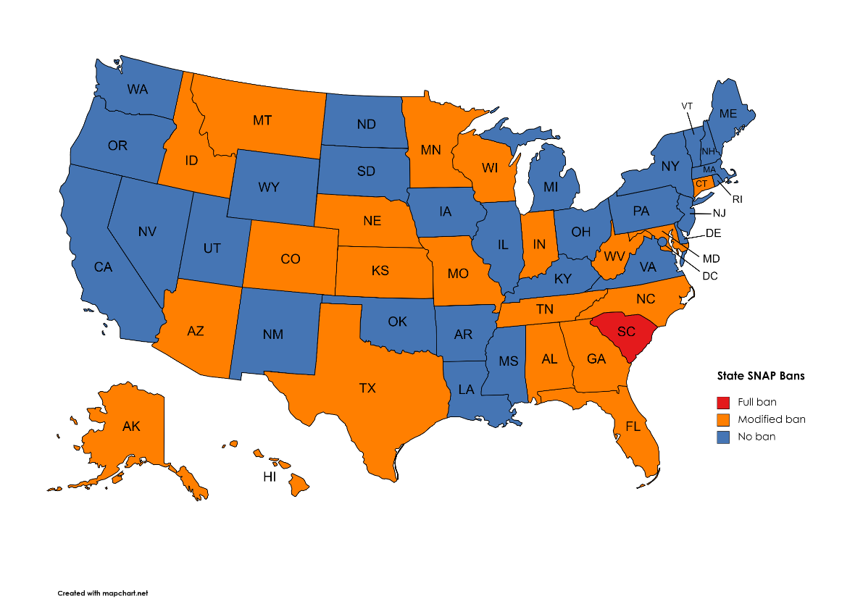
The RESTORE Act
Repeal SNAP’s lifetime exclusion for persons convicted of drug felonies
Many states have opted out
21 states have modified bans
28 states + DC have eliminated the ban
#NETWORKWebinar | @NETWORKLobby
Notes:
Repeal of SNAP’s lifetime exclusion of persons ever convicted of drug felonies is LONG overdue
RESTORE Act will end this ban and must be included in Farm Bill
Ban is immoral
Repealing ban honors SNAP’s basic purpose: to prevent hunger
Formerly incarcerated individuals already paid debt to society
Ban punishes families and children of returning individuals
Families receive far lower SNAP benefits when a parent is ineligible
Children face risk of hunger, along with the health and education harms of living in poverty

Slide 20
The SNAP Ban
Immoral
Violates any notion of a fair and just criminal legal system
Harmful to re-entry
Counter-productive as a public safety measure
#NETWORKWebinar | @NETWORKLobby
Notes:
Ban is immoral
Repealing ban honors SNAP’s basic purpose: to prevent hunger
Formerly incarcerated individuals already paid debt to society
Ban punishes families and children of returning individuals
Families receive far lower SNAP benefits when a parent is ineligible
Children face risk of hunger, along with the health and education harms of living in poverty
Ban violates any notion of fair and just criminal justice system
Perpetual punishment unrelated to individual’s offense
Harmful to individual’s re-entry into the community
Most have few-to-no personal assets and face hostile labor market
Inability to afford food for self or family can doom hope of successful re-entry
Counter-productive as public safety measure
Studies show less recidivism for returning individuals with SNAP than those barred from benefits
Bars participation in SNAP’s job training programs that can prevent recidivism

Slide 21
Our Goal
Resist any new cuts to SNAP or additional work requirements
Include the RESTORE Act
#NETWORKWebinar | @NETWORKLobby
Notes:
As Congress considers the Farm Bill and agriculture appropriations over the coming months, Network will:
Resist any new, devastating cuts and additional work requirements
Fully support the RESTORE Act

Slide 22
TAKE ACTION
Call your Member of Congress on Tuesday, September 26
Write a letter to the editor
#NETWORKWebinar | @NETWORKLobby

